Slide 1
Entity Framework
Entity Framework Basics

Slide 2

Lesson Objectives
Overview Entity Framework
EF Architecture
EF Features

Slide 3
Lesson Objectives
Workflow in Entity Framework
Entity State
Development approaches
Discussion and Feedback

Slide 4
Overview Entity Framework
Section 1

Slide 5
Did you work with ADO.NET?
Save or retrieve application data from the underlying database
Boring with repeating code:
open a connection to the database
create a DataSet to fetch or submit the data to the database
convert data from the DataSet to .NET objects or vice-versa to apply business rules

Slide 6
Did you work with ADO.NET?
Stressful when:
Cannot remember all SQL schema and data
Forget to close connection
Exception when database changed without any notification
SQL Injection
…..

Slide 7
What is Entity Framework?
Automate all database related activities
Open-source ORM framework for .NET applications
Supported by Microsoft

Slide 8
What is Entity Framework?
Enables developers to work with data using objects of domain specific classes without focusing on the underlying database tables and columns where this data is stored

Slide 9
What is Entity Framework?
Enables developers to work with data using objects of domain specific classes without focusing on the underlying database tables and columns where this data is stored
Developers can work at a higher level of abstraction when they deal with data, and can create and maintain data-oriented applications with less code compared with traditional applications

Slide 10
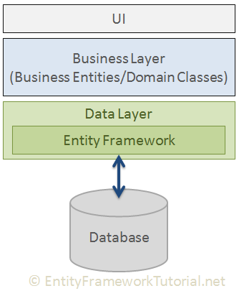
What is Entity Framework?
“Entity Framework is an object-relational mapper (O/RM) that enables .NET developers to work with a database using .NET objects. It eliminates the need for most of the data-access code that developers usually need to write.”

Slide 11
EF Architecture
Section 2

Slide 12
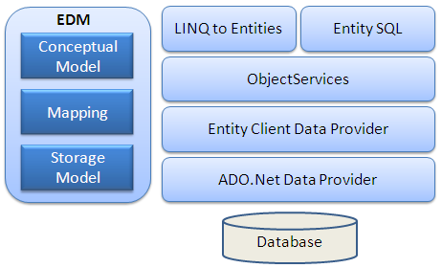
Entity Framework Architecture
EDM: Entity Data Model
Conceptual Model: The conceptual model contains the model classes and their relationships. This will be independent from your database table design.

Slide 13
Entity Framework Architecture
Mapping: Mapping consists of information about how the conceptual model is mapped to the storage model.
Storage Model: The storage model is the database design model which includes tables, views, stored procedures, and their relationships and keys.

Slide 14
Entity Framework Architecture
LINQ to Entities: LINQ-to-Entities (L2E) is a query language used to write queries against the object model. It returns entities, which are defined in the conceptual model. You can use your LINQ skills here.

Slide 15
Entity Framework Architecture
Entity SQL: Entity SQL is another query language (For EF 6 only) just like LINQ to Entities. However, it is a little more difficult than L2E and the developer will have to learn it separately.

Slide 16
Entity Framework Architecture
Object Service: Object service is a main entry point for accessing data from the database and returning it back. Object service is responsible for materialization, which is the process of converting data returned from an entity client data provider (next layer) to an entity object structure.

Slide 17
Entity Framework Architecture
Entity Client Data Provider: The main responsibility of this layer is to convert LINQ-to-Entities or Entity SQL queries into a SQL query which is understood by the underlying database. It communicates with the ADO.Net data provider which in turn sends or retrieves data from the database.

Slide 18
Entity Framework Architecture
ADO.Net Data Provider: This layer communicates with the database using standard ADO.Net.

Slide 19
EF Features
Section 3

Slide 20
Entity Framework Features
Cross-platform
EF Core is a cross-platform framework which can run on Windows, Linux and Mac.
Modelling
EF (Entity Framework) creates an EDM (Entity Data Model) based on POCO (Plain Old CLR Object) entities with get/set properties of different data types. It uses this model when querying or saving entity data to the underlying database.
…

Slide 21
Entity Framework Features
Querying
EF allows us to use LINQ queries (C#/VB.NET) to retrieve data from the underlying database. The database provider will translate this LINQ queries to the database-specific query language (e.g. SQL for a relational database). EF also allows us to execute raw SQL queries directly to the database.
Change Tracking
EF keeps track of changes occurred to instances of your entities (Property values) which need to be submitted to the database.
…

Slide 22
Entity Framework Features
Saving
EF executes INSERT, UPDATE, and DELETE commands to the database based on the changes occurred to your entities when you call the SaveChanges() method. EF also provides the asynchronous SaveChangesAsync() method.
Concurrency
EF uses Optimistic Concurrency by default to protect overwriting changes made by ano
ther user since data was fetched from the database.
…

Slide 23
Entity Framework Features
Transactions
EF performs automatic transaction management while querying or saving data. It also provides options to customize transaction management.
Caching
EF includes first level of caching out of the box. So, repeated querying will return data from the cache instead of hitting the database.
…

Slide 24
Entity Framework Features
Built-in Conventions
EF follows conventions over the configuration programming pattern, and includes a set of default rules which automatically configure the EF model.
Configurations
EF allows us to configure the EF model by using data annotation attributes or Fluent API to override default conventions.
…

Slide 25
Entity Framework Features
Migrations
EF provides a set of migration commands that can be executed on the NuGet Package Manager Console or the Command Line Interface to create or manage underlying database Schema.

Slide 26
Workflow in Entity Framework
Section 4

Slide 27
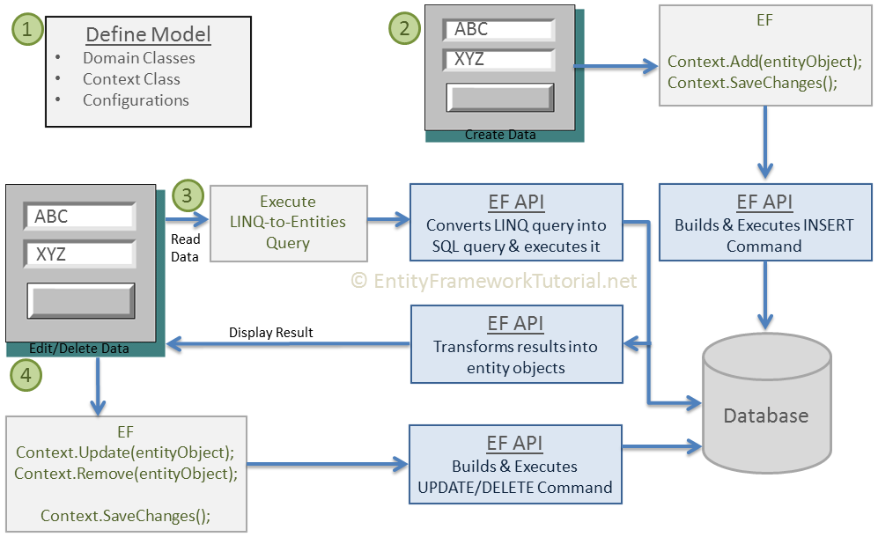
Basic Workflow in EF

Slide 28
Define model
Defining the model includes defining
domain classes,
context class derived from DbContext,
configurations (if any).

Slide 29
Define model
EF will perform CRUD operations based on your model.
CRUD:
Create
Read
Update
Delete

Slide 30
Define model
Entity Framework API (EF6 & EF Core) includes the ability to map domain (entity) classes to the database schema, translate & execute LINQ queries to SQL, track changes occurred on entities during their lifetime, and save changes to the database.

Slide 31
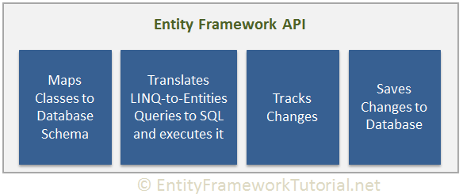
Define model
Entity Framework API (EF6 & EF Core) includes the ability to map domain (entity) classes to the database schema, translate & execute LINQ queries to SQL, track changes occurred on entities during their lifetime, and save changes to the database.

Slide 32
Insert data
Add a domain object to a context
Call the SaveChanges() method.
EF API will build an appropriate INSERT command and execute it to the database.

Slide 33
Insert data
Add a domain object to a context
Call the SaveChanges() method.
EF API will build an appropriate INSERT command and execute it to the database.
Question: Can we add more than one object at the time?

Slide 34
Read data
Execute the LINQ-to-Entities query in your preferred language (C#/VB.NET).
EF API will convert this query into SQL query for the underlying relational database and execute it.
The result will be transformed into domain (entity) objects and ready for display

Slide 35
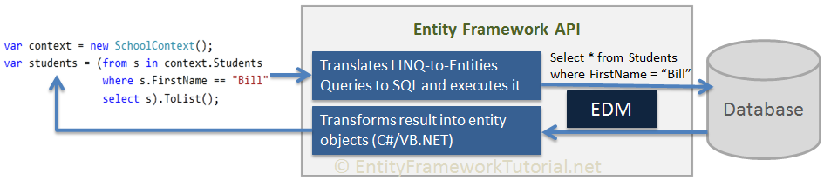
Read data
EF API translates LINQ-to-Entities queries to SQL queries for relational databases using EDM and also converts results back to entity objects.

Slide 36
Edit or Delete data
Update or Remove entity objects from a context
Call the SaveChanges() method.
EF API will build the appropriate UPDATE or DELETE command and execute it to the database.

Slide 37
Edit or Delete data
Update or Remove entity objects from a context
Call the SaveChanges() method.
EF API will build the appropriate UPDATE or DELETE command and execute it to the database.
Question: What happed if we forget calling SaveChanges()?

Slide 38
Entity State
Section 5

Slide 39
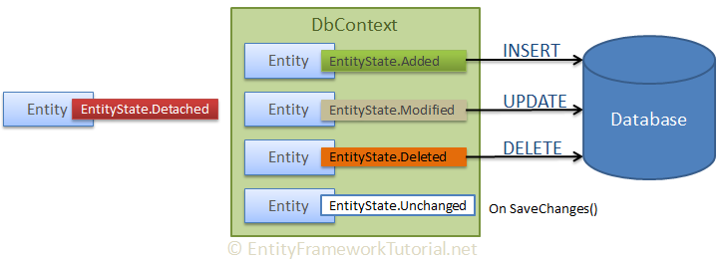
Entity State
EF API maintains the state of each entity during an its lifetime.
Each entity has a state based on the operation performed on it via the context class.

Slide 40
Entity State
The entity state are:
Added
Modified
Deleted
Unchanged
Detached

Slide 41
Development approaches
Section 6

Slide 42
Development Approaches
There are three different approaches you can use while developing your application using Entity Framework:
Database-First
Code-First
Model-First

Slide 43
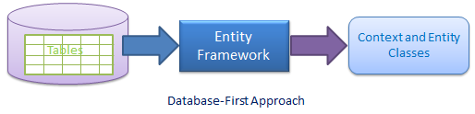
Database-First Approach
In the database-first development approach, you generate the context and entities for the existing database using EDM wizard integrated in Visual Studio or executing EF commands.
EF 6 supports the database-first approach extensively.
EF Core includes limited support for this approach.

Slide 44
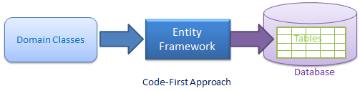
Code-First Approach
Use this approach when you do not have an existing database for your application.
start writing your entities (domain classes) and context class first
create the database from these classes using migration commands.
Why do developers prefer this approach?

Slide 45
Code-First Approach
Why do developers prefer this approach?

Slide 46
Model-First Approach
In the model-first approach, developer
creates entities, relationships,
inheritance hierarchies directly on the visual designer integrated in Visual Studio
generate entities, the context class, and the database script from your visual model.

Slide 47
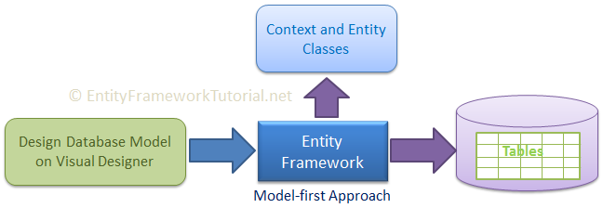
Model-First Approach
EF 6 includes limited support for this approach.
EF Core does not support this approach.

Slide 48
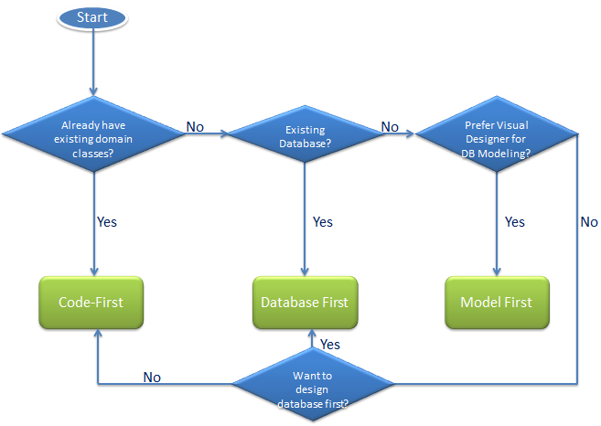
Choosing the Approach

Slide 49
Discussion
With Entity Framework, developer does NOT need to know SQL?

Slide 50
Discussion
What is/are disadvantage(s) of Entity Framework?
Notes:
https://cybarlab.com/advantages-and-disadvantages-of-ef
Advantages of Entity Framework The advantages of EF are given bellow:
It provides auto generated code
It reduce development time
It reduce development cost
It enables developers to visually design models and mapping of database
It provides capability of programming a conceptual model.
It provides unique syntax (LINQ / Yoda) for all object queries whether it is database or not
It allow multiple conceptual models to mapped to a single storage schema
It’s easy to map business objects (with drag & drop tables).
Disadvantages of Entity Framework The disadvantages of EF are given bellow:
Lazy loading is the main drawbacks of EF
Its syntax is complicated
Its logical schema is not able to understand business entities and relation among each other
Logical schema of database is not capable of using certain parts of application
It is not available for every RDMS
Need to handle data in nontraditional way
It does not work if we change any schema of the database. We need to update the schema on the solution.
It is not good for huge domain model.

Slide 51
Give your feedback
Should you use Entity Framework or not?
Explain your decision:

Slide 52

Thank you

